Slide 1


INF 558 Final Project:
Korean-Pop WIKI
Xiaoyue Chen
Qiuke Wang

Slide 2


Popularity Prediction
Searching
Recommending
Presenting statistic and trends with data visualization.
Objective

Slide 3
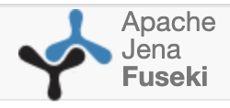



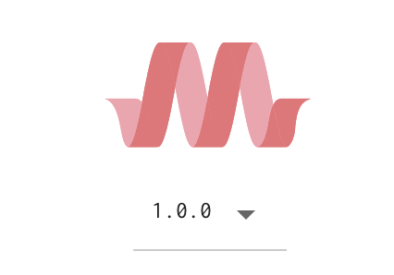


Process & Tools
Data Crawling
Mapping to
ontology
Entity Linking
Knowledge
Graph
Query & Web
Regular expression
usc-isi-i2/rltk
String similarity
BeautifulSoup
Web API

Slide 4
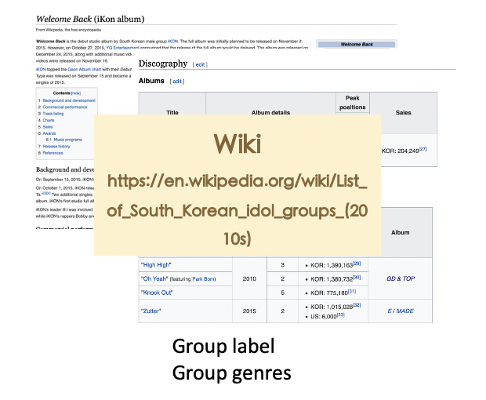
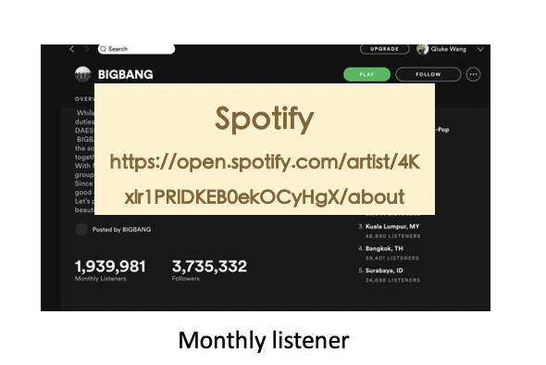
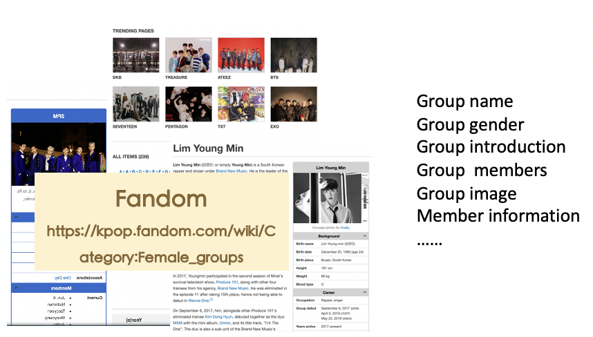
Data
Sources

Slide 5
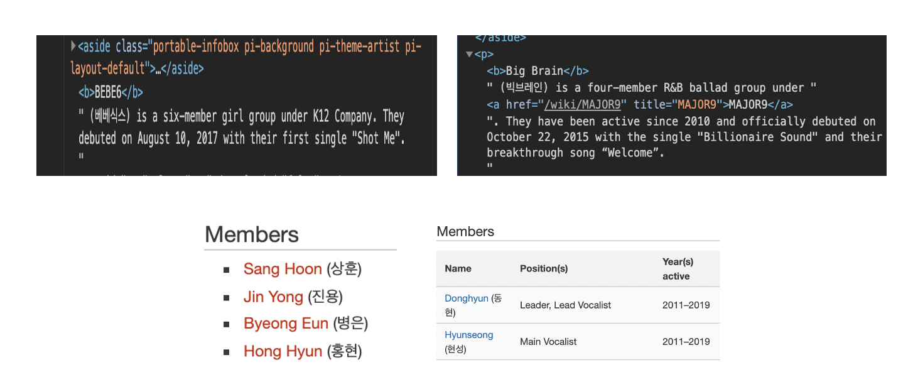
Data Crawling
Challenge: inconsistent structure
Solution:
Optimizing spider and take more cases into consideration.

Slide 6
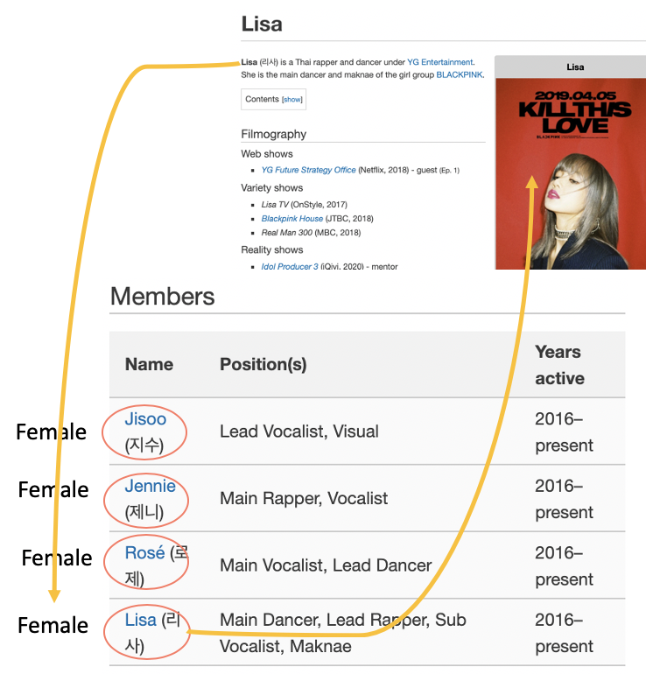
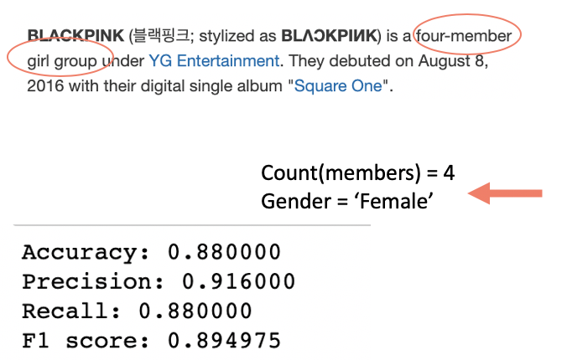
Data Crawling
Challenge: missing information
Group gender: Girl group or Boy group or Co_ed group? Number of group member? How to measure popularity?
Solution:
Extracting desired information from unstructured data(introduction) or inferring from known knowledge.

Slide 7
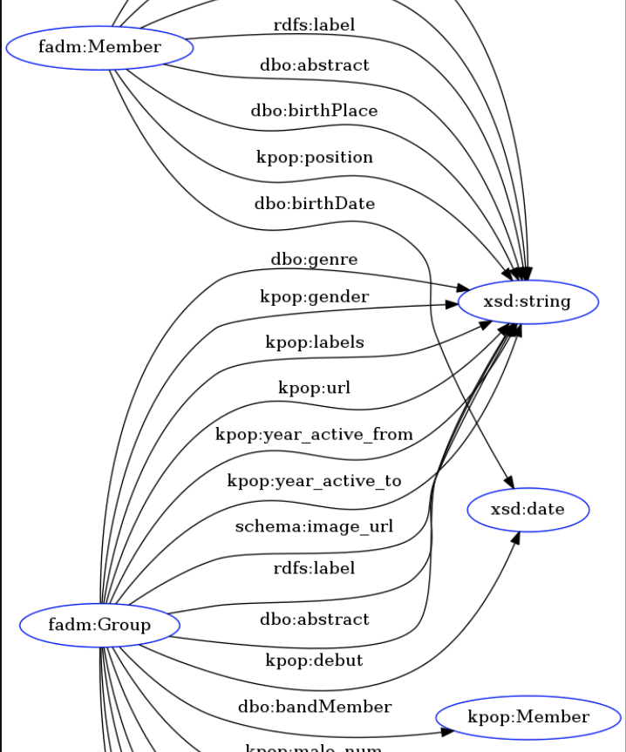
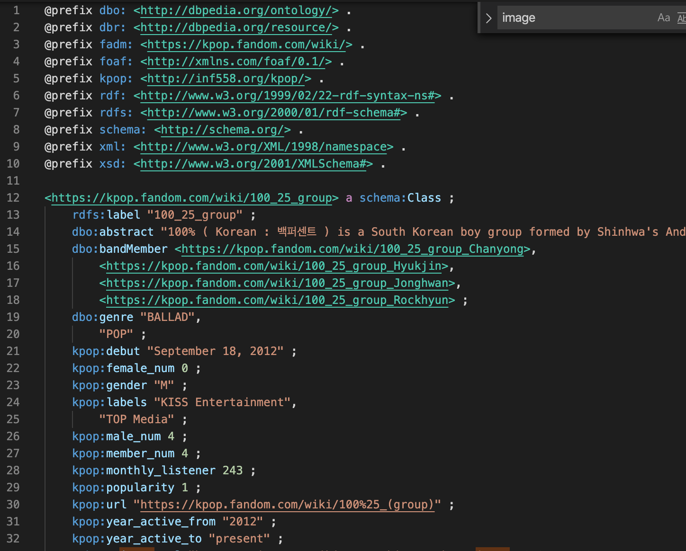
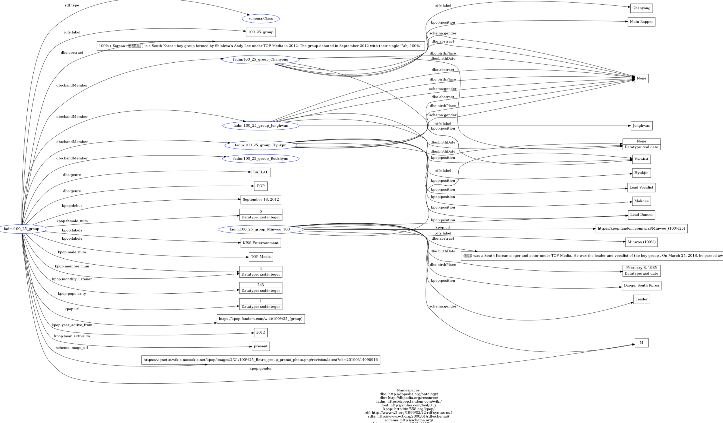
Ontology

Slide 8
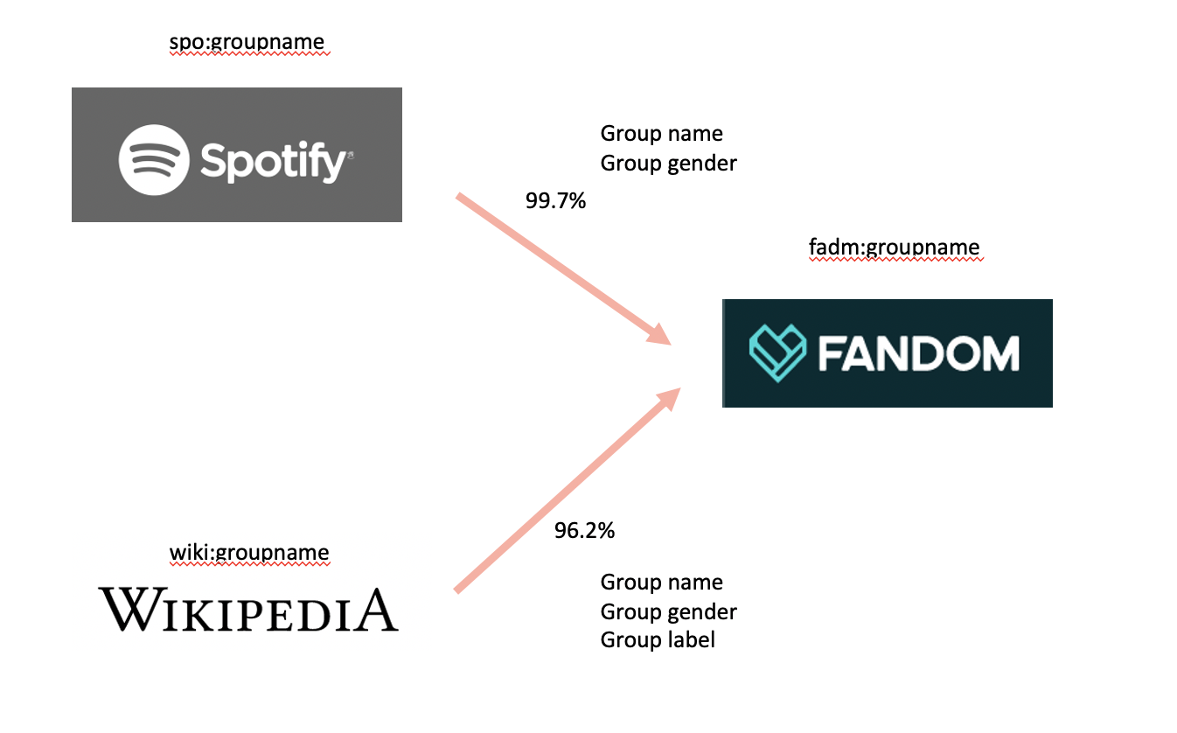
Entity Linking

Slide 9
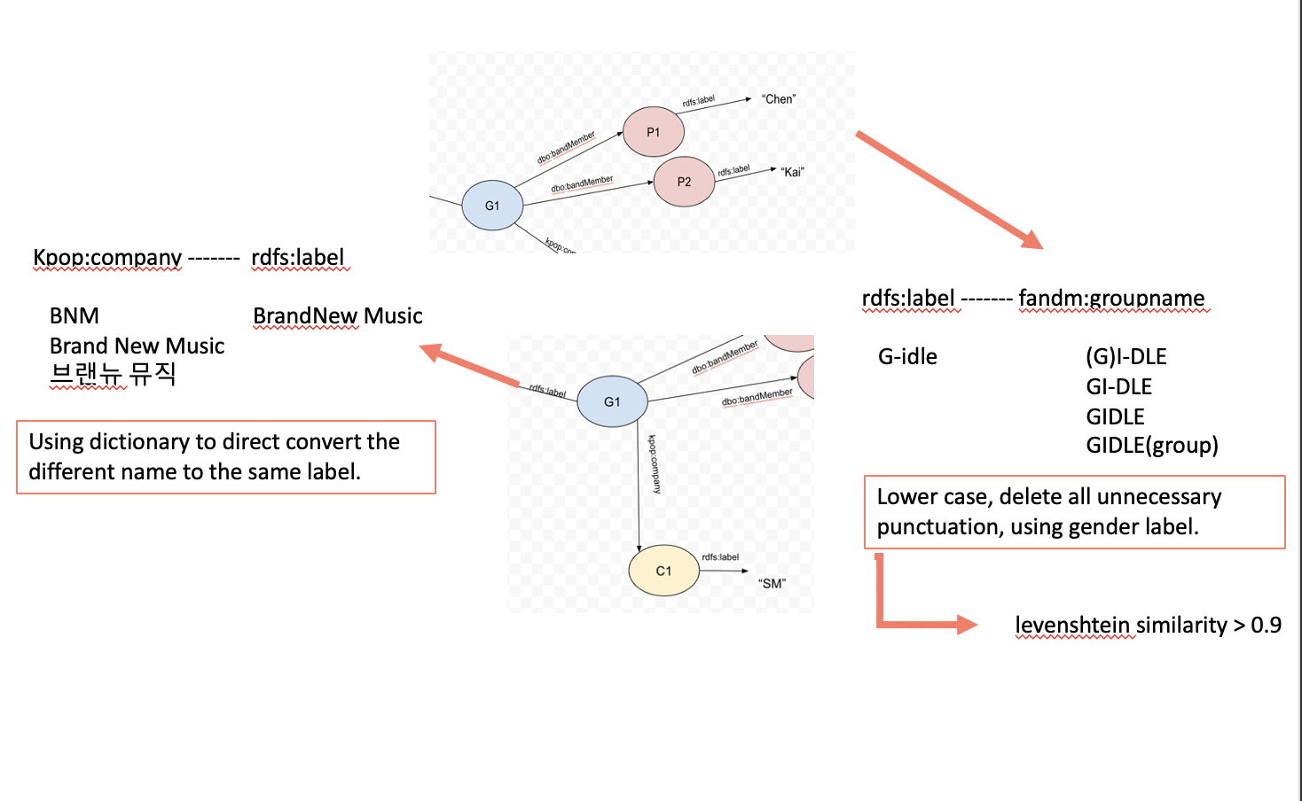
Entity Resolution

Slide 10
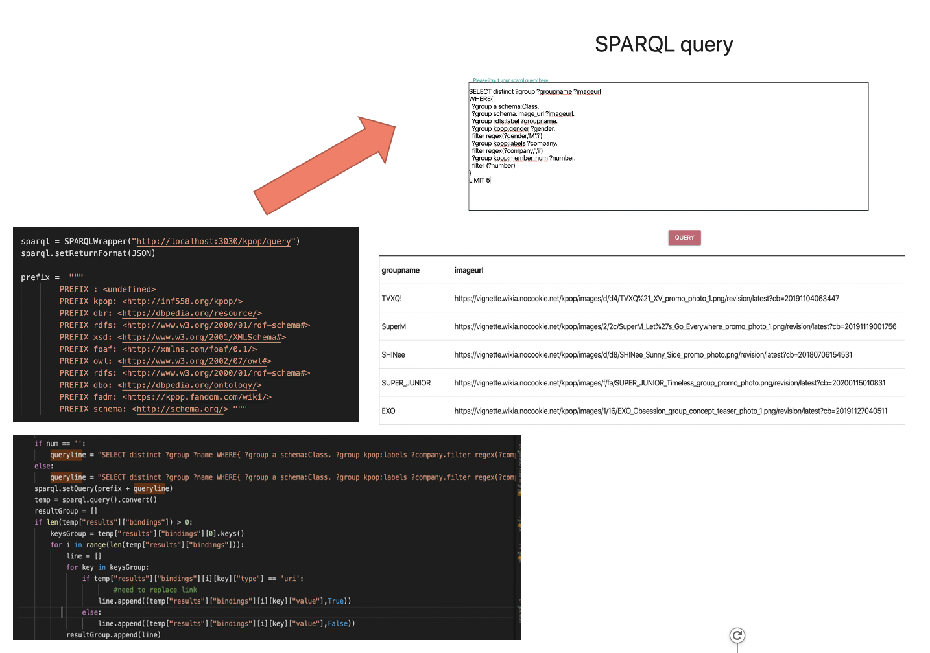
SPARQL

Slide 11

Choosing KG Plateforms
Apach Jena provides Fuseki components.
Fuseki is a SPARQL server that supports the SPARQL language for retrieval and runs efficiently on both stand-alone and server sides.
For the web application we built, we do need more query functions than the visualization.
vs

Slide 12
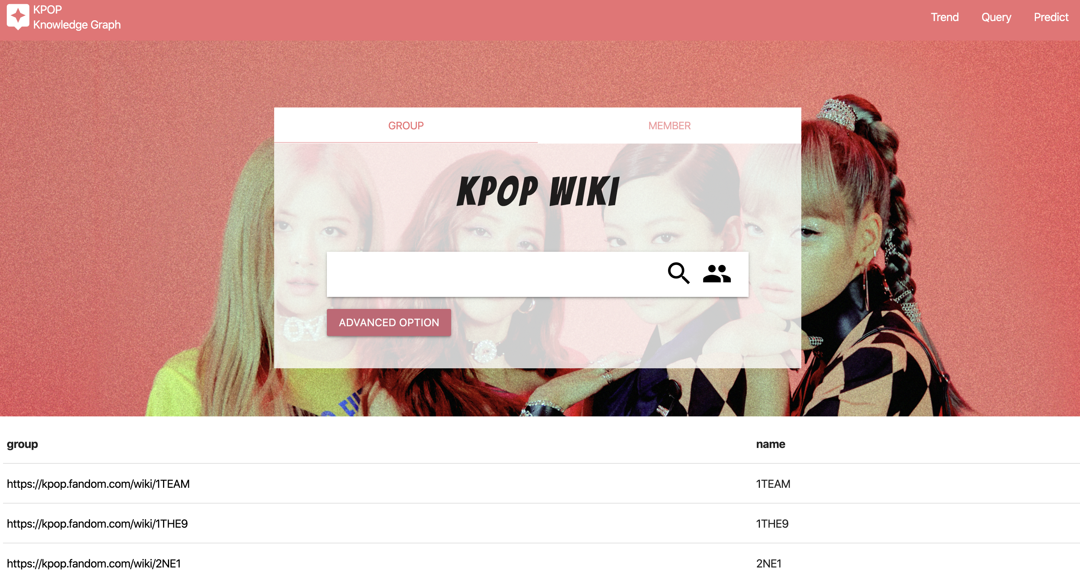
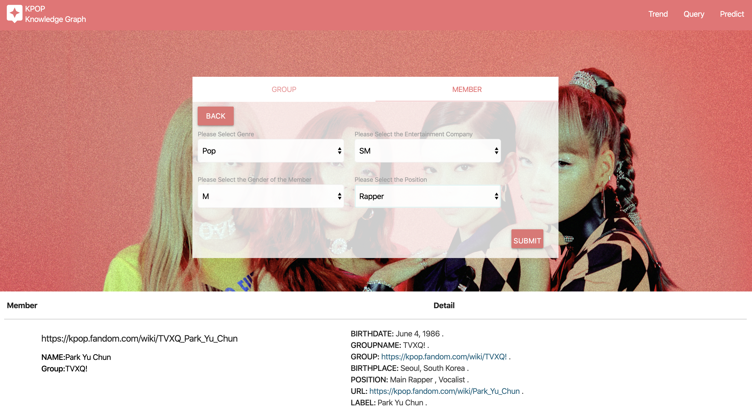
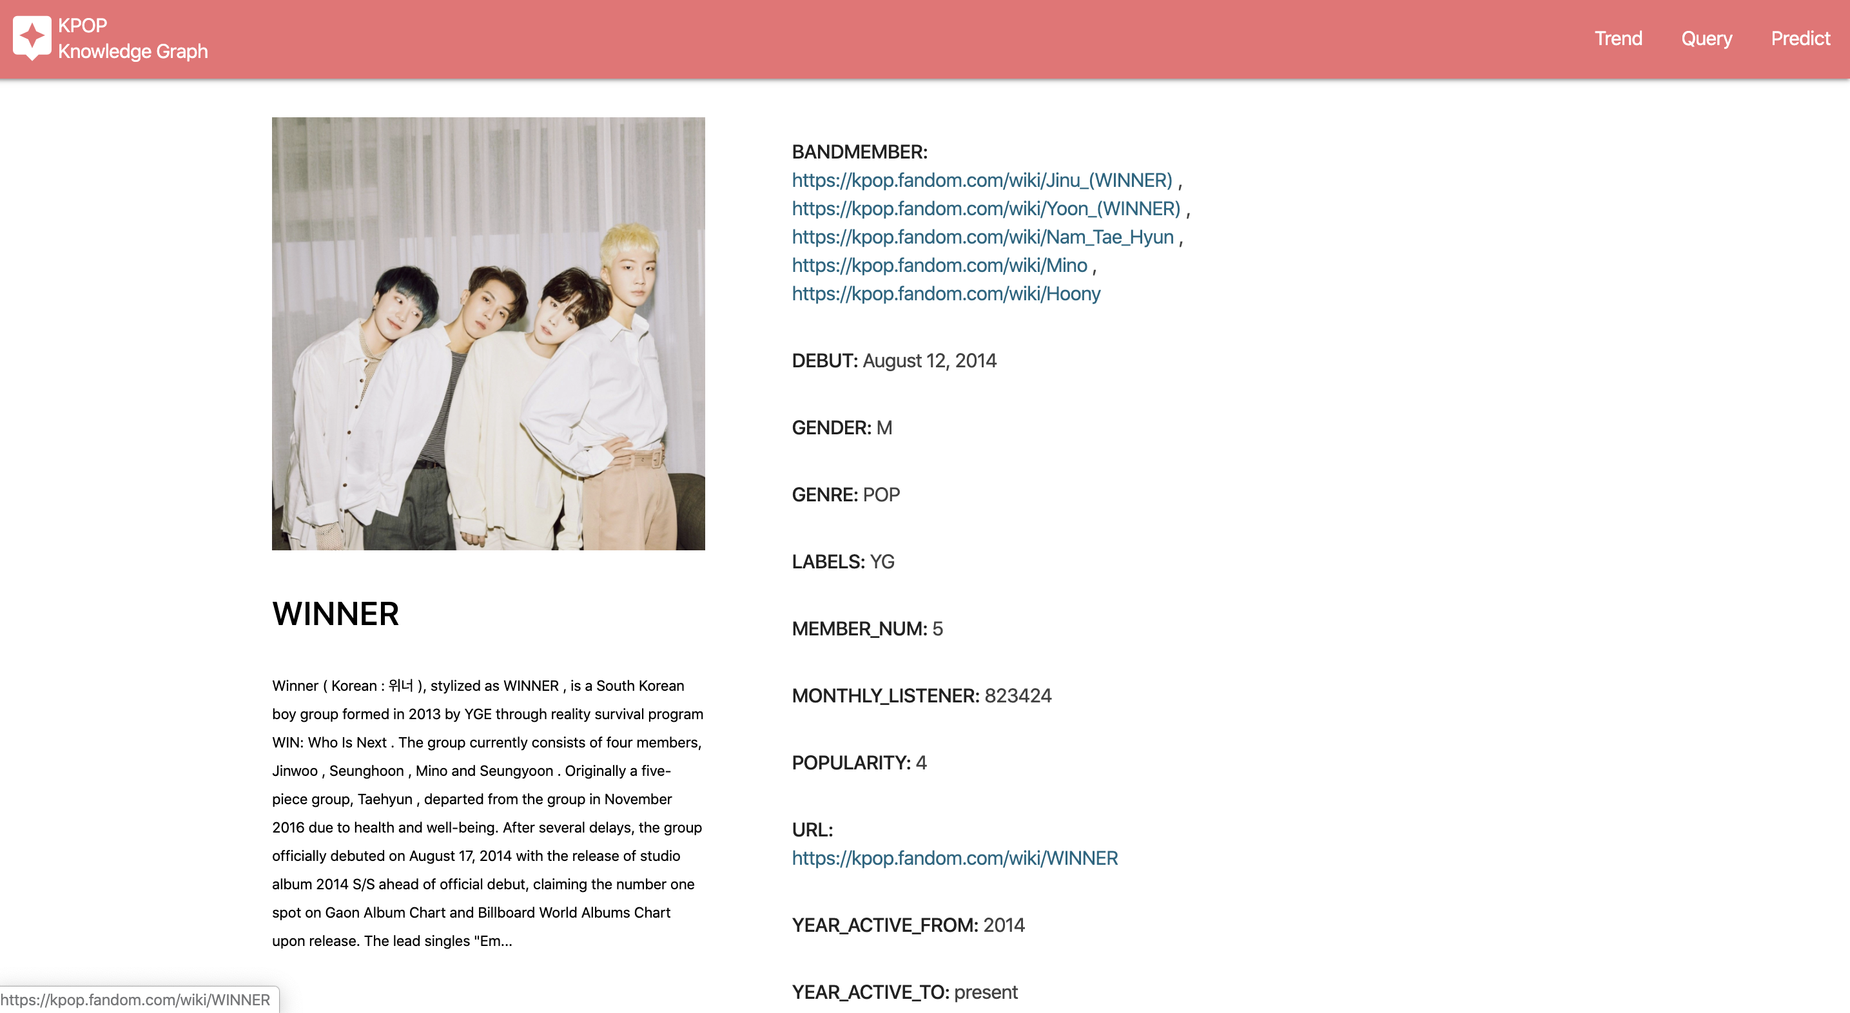
Web
search & detail Page
General Search(name)
Advanced Search
Search Group
Search Member

Slide 13
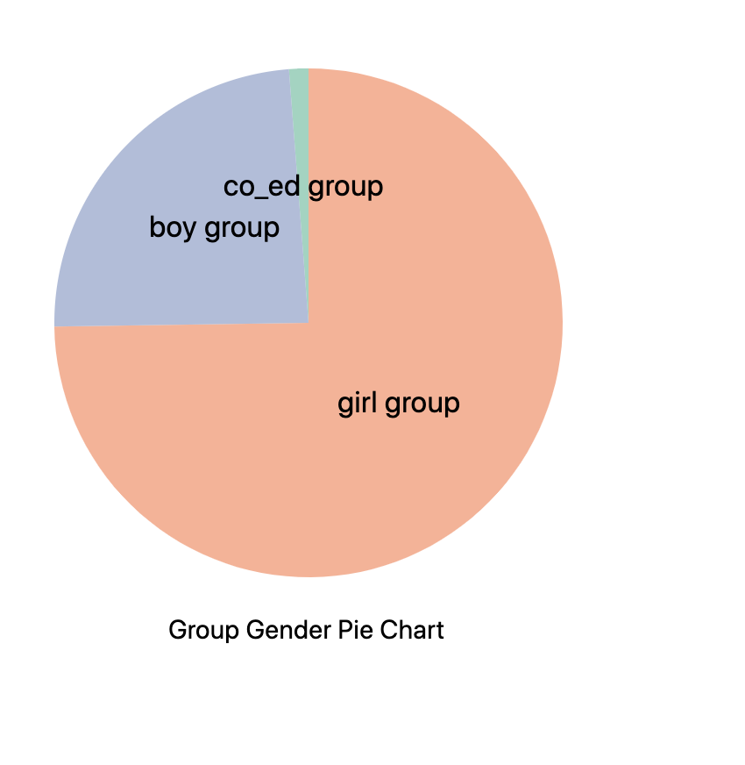
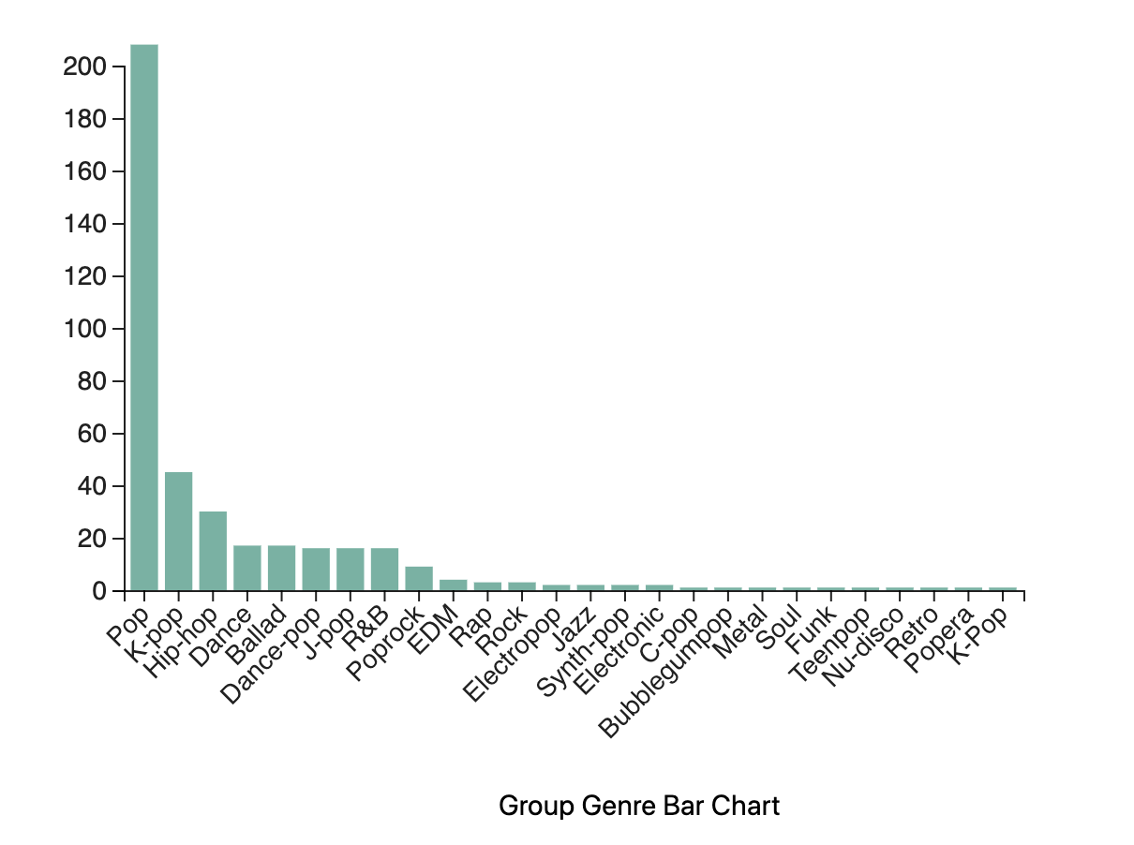
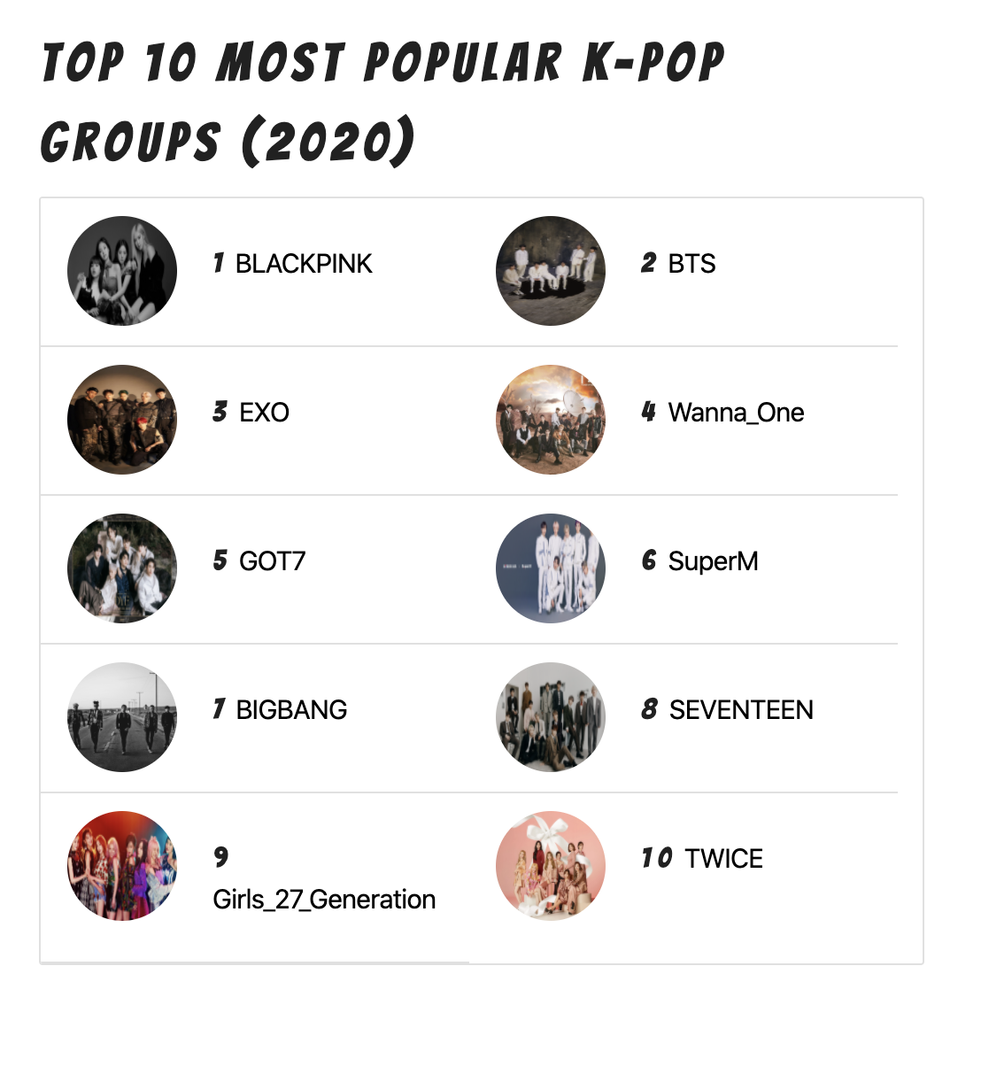
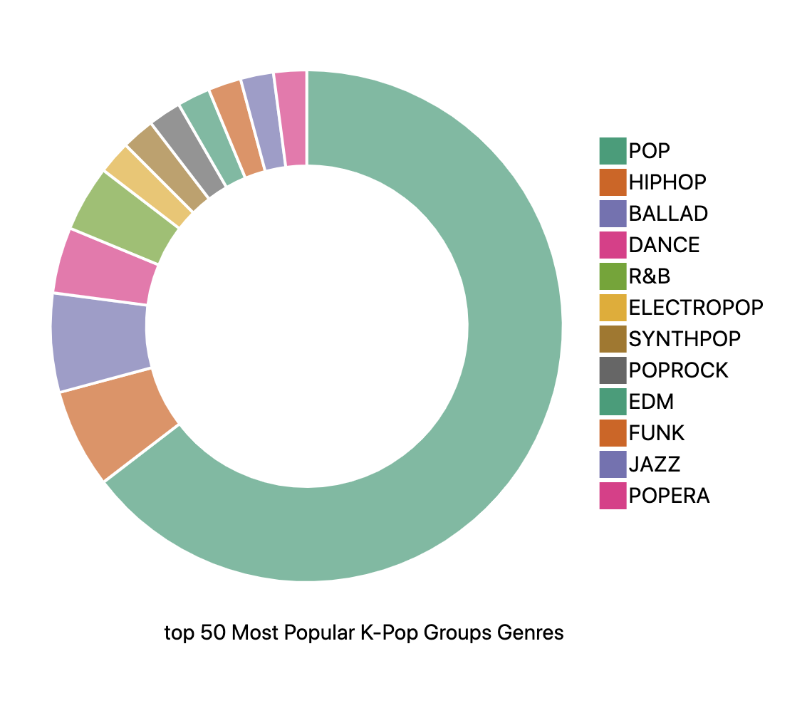
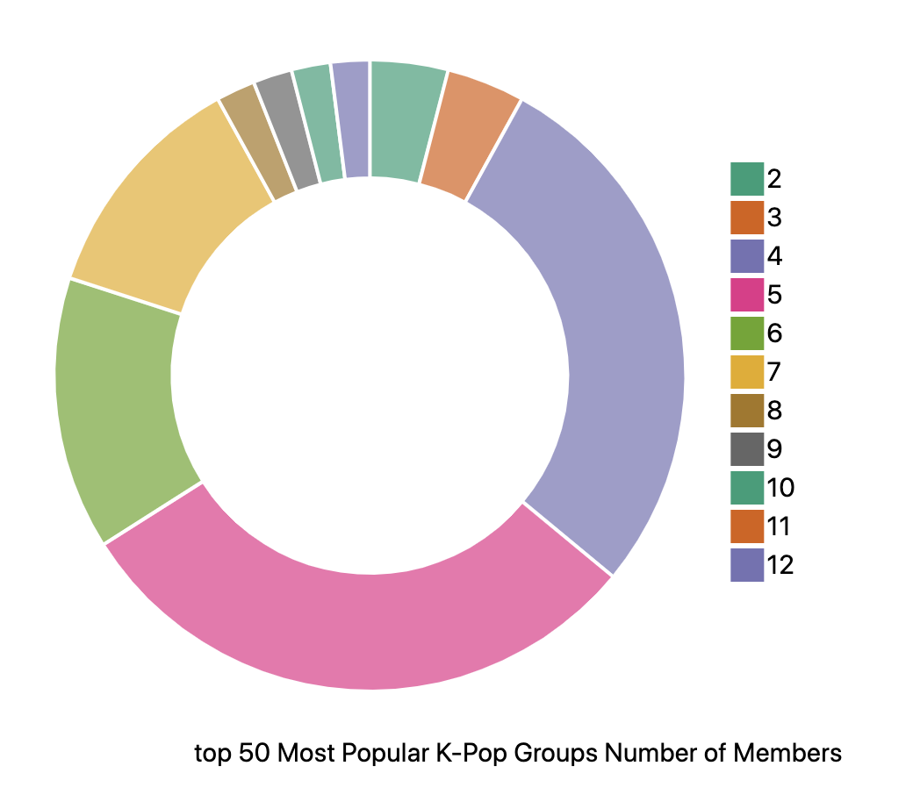
Trend Page
Trend Overview
Group Overview

Slide 14
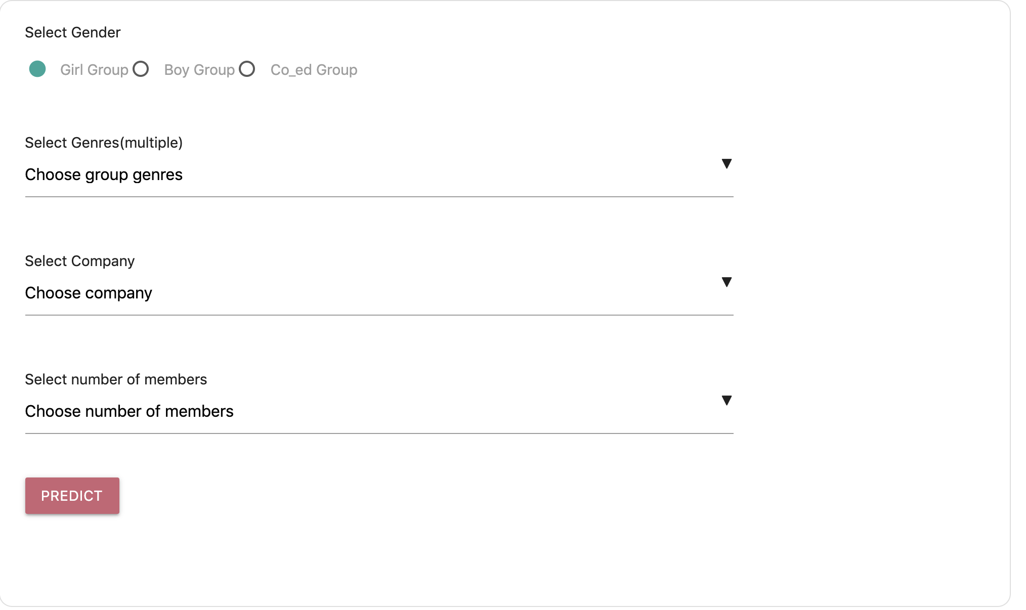
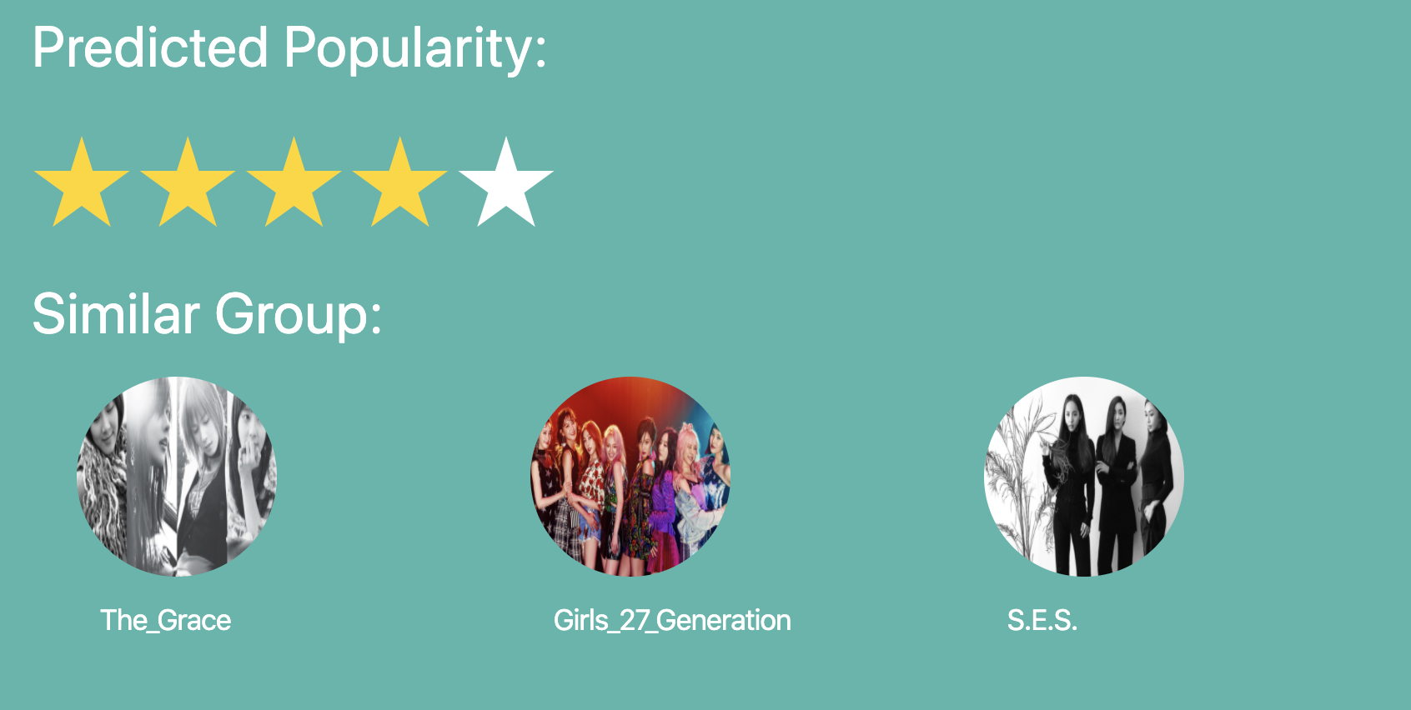
Predict Popularity
How to predict popularity when we can’t find similar group?
Solution:
Embedding the features(genre, gender, company and number of members). Train SVM + linear regression model. Query the avg popularity basing on different features, then add the predict score of our model. Using voting method to get the final score.
Machine Learning
Find
Similarity
+
+
SPARQL

Slide 15
Evaluation
Data Crawling
Mapping to
ontology
Entity Linking
Query & Web
Reviewing the data scraping from the web. Analyzing the wrong data and improve the spider.
Using RDF validation tool.
Labeling the test data manually and detect the accuracy.
Using SPARQL to test on the data and validate manually.

Slide 16
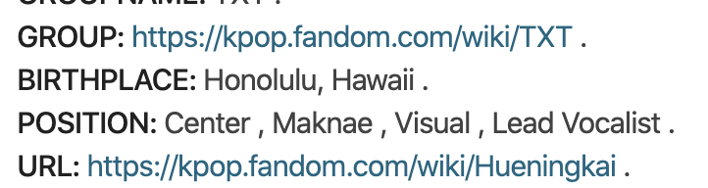
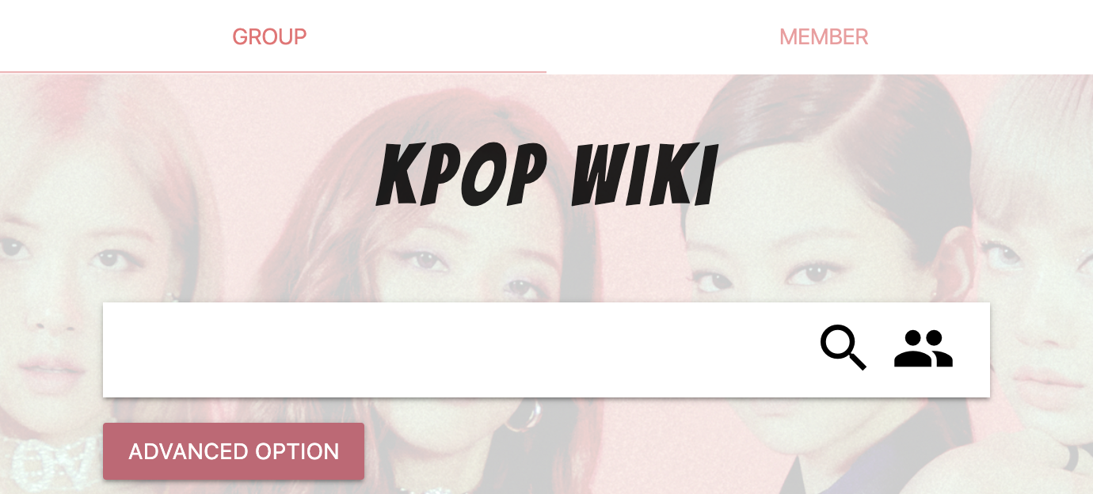
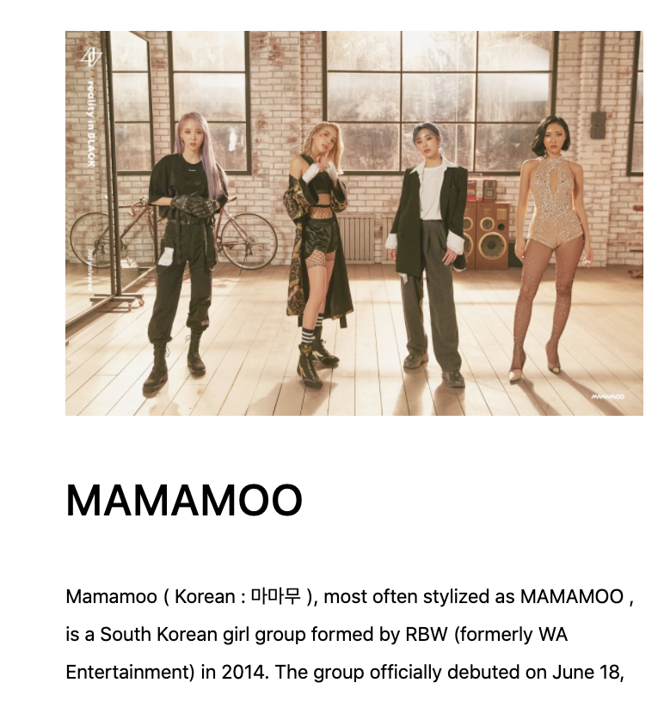
Improvement
We invited friends to help us test the whole application. We built a more user-friendly project according to their feedback.
1. Add more hyper-links
In the member detail page, we add not only the attributes belonging to the member, but also the group information the member belongs to.
User Friendly
2. Change UI
After listening to users’ advice, we combined the group search and member search together into one page using tab.
3. Retrieve more information
In order to present the images of each member and group., we crawled the data source again to make the description page looks better.

Slide 17
Conclusion
Data Acquisition
Data Clean
Create Ontology
Semantic Mapping
Entity Linking
SPARQL
Analysis Trend
Find Similarity
Build Web Project
The system helps us to digest all the knowledge we learnt from the class. From crawling data to building a full-stack web project.
We learnt that knowledge graph is a better way when trying to analyze complicate relationships among different entities.
With the trend page and predict tool, we have a better understanding of data visualization and machine learning.

Slide 18
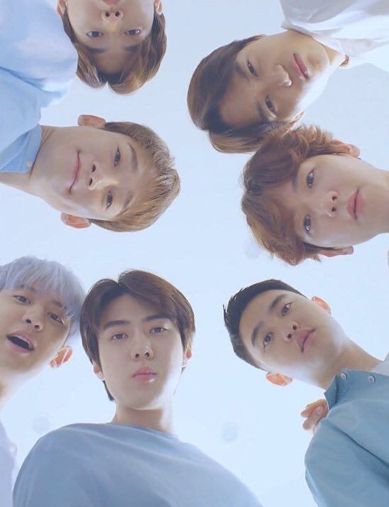
Thank You for Watching!

